Slide 1
Build Smart City Neural Networks by Using a Smart Pole as a Node — Huawei Smart Pole Solution
Enterprise Network SDT

Slide 2





Smart City: Better Construction and Management of Cities Using Information Technologies
Smart City refers to using new-generation technologies — such as the IoT, cloud computing, and big data — to collect and analyze data, thus opmizing city planning, construction, and management.
Data Collection
Data Convergence
Data Application
Information collection and transmission are the basis of Smart Cities

Slide 3


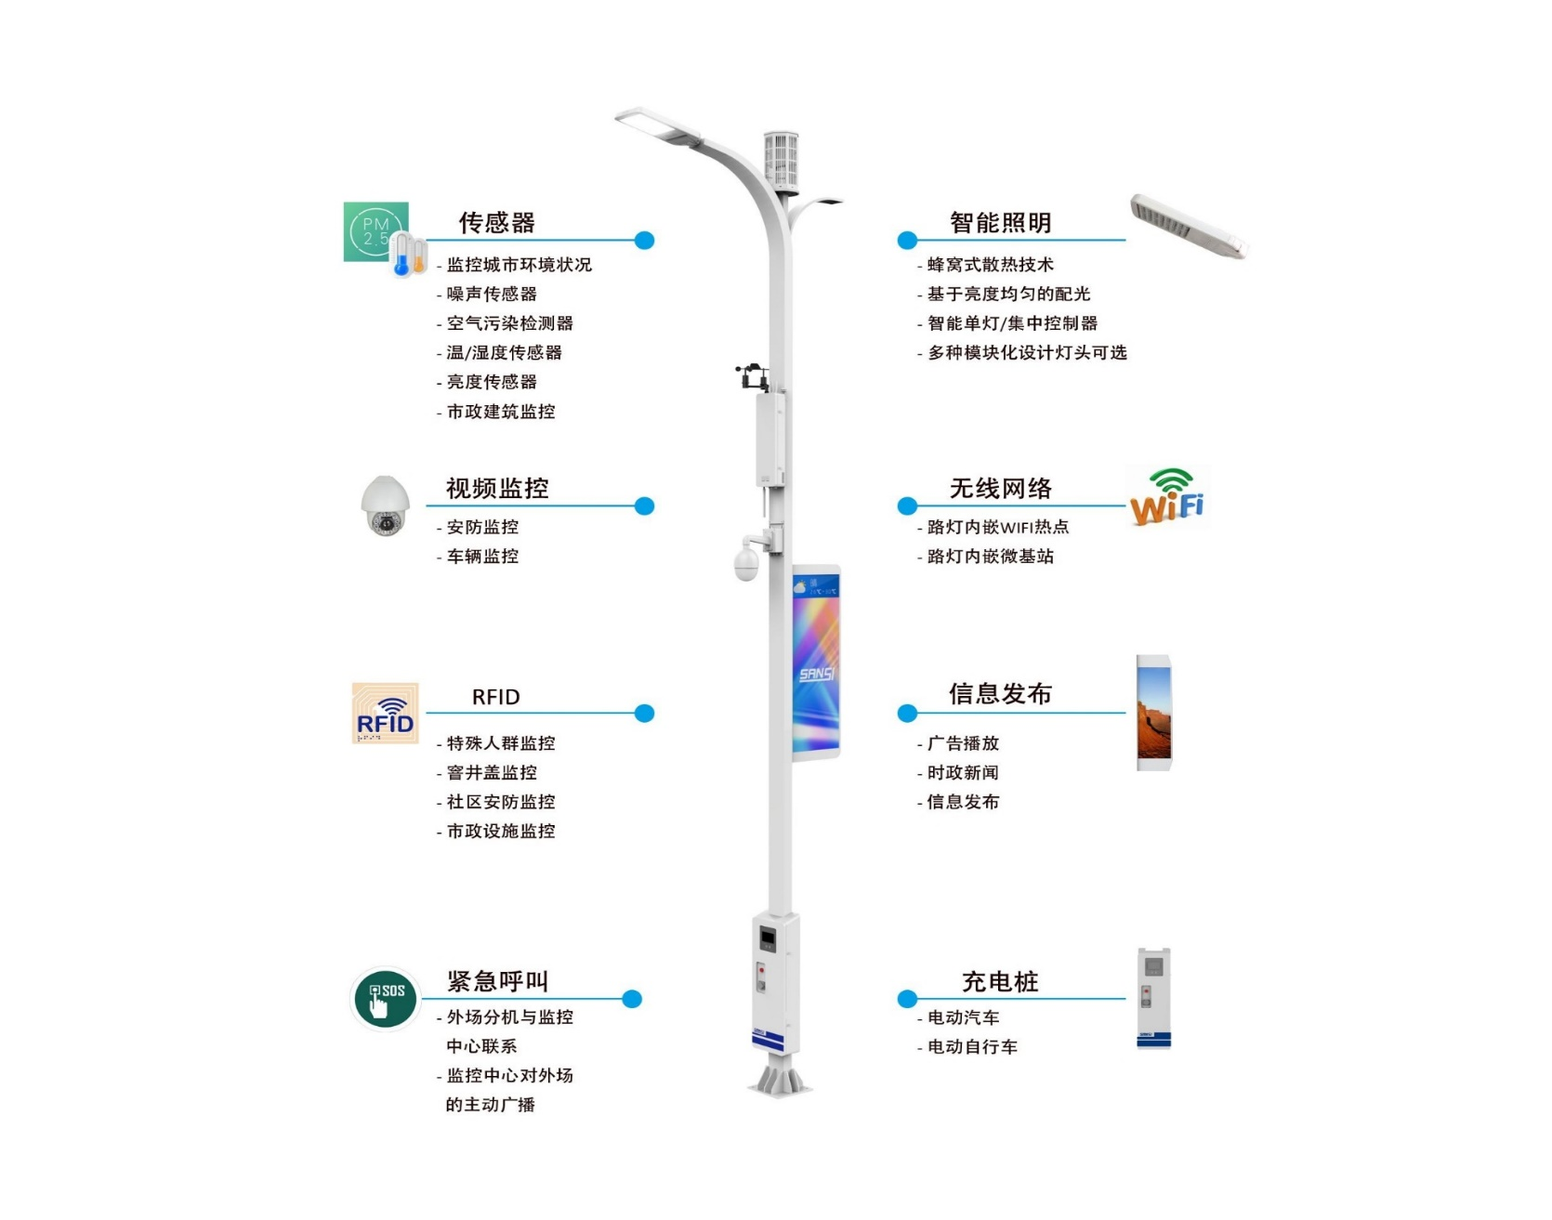
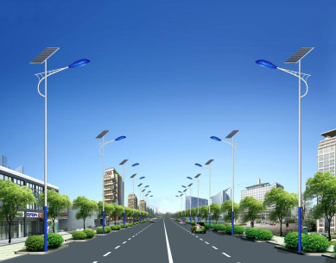
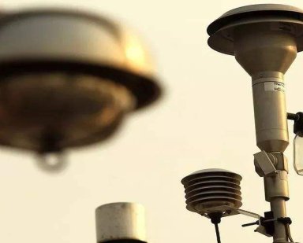








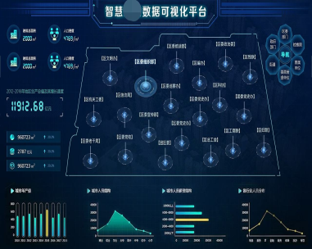



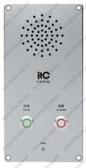
Smart Pole: the Best Node for Smart City Information Collection
Intelligent Lighting
Wireless Network
Wide distribution
Good location
Convenient transmission
Video Surveillance
Environmental acquistion
Pedestrian flow analysis
1. Rich IoT: “Neural Network” of the city
Environmental Monitoring
Video Surveillance
2. Access Node: “Rapid Socket” of the city
Wireless Internet access
Information Release
Panic button
Public lighting mgmt.
Municipal administration
Traffic surveillance
Emergency Call
Information Release
3. Convenience System: “Know-all” of the city
4. Management Platform: “Smart Brain” of the city

Slide 4
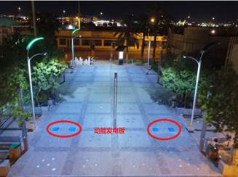

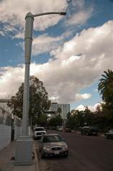
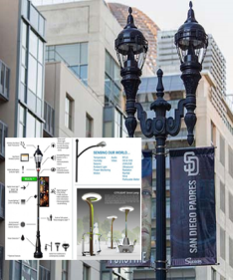
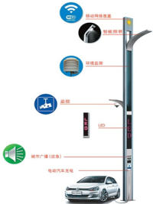
Development Trend of Overseas Smart Poles
Solar and kinetic energy to charge the poles in Las Vegas
Paris street lights provide Wi-Fi and seating
Having the function of lighting and testing air quality, while relying on solar energy and kinetic energy to power the pole
In addition to providing basic lighting, Paris’s smart street lights also offer Wi-Fi and mobile phone charging
Los Angeles has 200,000+ smart connected street lights
San Diego has more than 3,200 smart light poles
Hong Kong launches multi-functional smart pole test plan
Newly introduced acoustic sensors and environmental noise-monitoring sensors detect vehicle collision events and provide timely information to the city’s emergency communications system
This smart light pole can monitor traffic, crowd size, weather conditions, and even detect gunshots, and automatically issue alarm warnings
The program integrates lighting, mobile base stations, video surveillance, information release, PM2.5 intelligent sensing, charging piles, and more to achieve better urban management

Slide 5
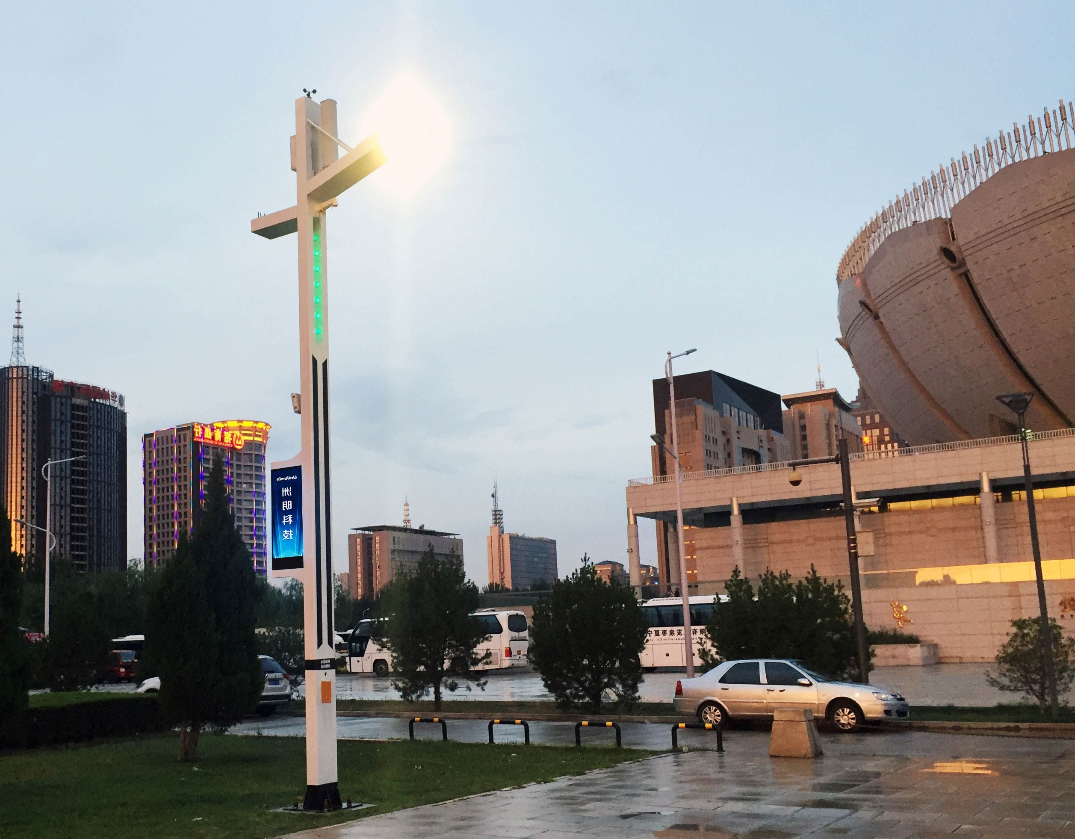
What
Can a smart pole bring to the city?

Slide 6
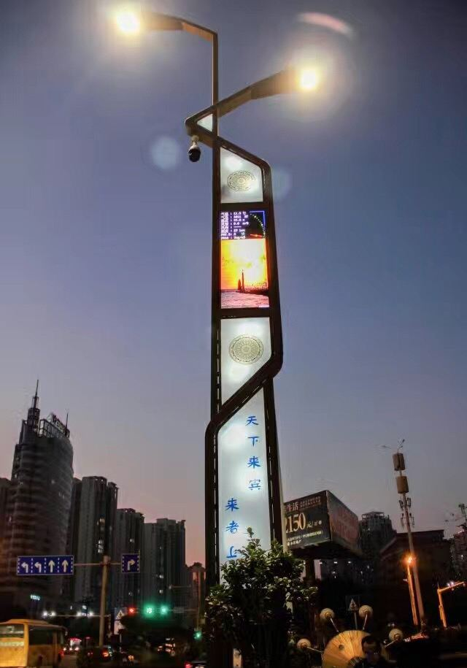
A Smart Pole is like a business card of the city. A Smart Pole highlights the attitude and determination of the city to innovate in science and technology.
With Smart Poles, the city can attract more scientists and technological talent, and bring more investment in science and technology.

Slide 7

On-Demand Lighting Reduces Public Lighting Power Consumption by 50%+
Lighting calendar based on longitude and latitude, season, and month
LED bulbs are more energy efficient
Lighting policy based on time period

Slide 8
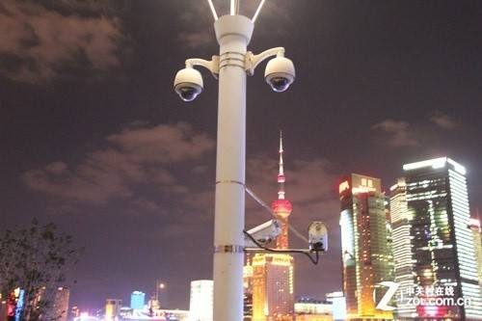
Build a Secure, Harmonious Life and an Investment Environment for Cities Through Information Security Devices
Video Surveillance
Pedestrian Flow Analysis
Visualized Alarm Reporting and Broadcast Notification
Panic Button and Video Linkage

Slide 9

Commodity Information Push
Wireless Surfing
Municipal Information Release
3G/4G/5G Micro Base Station
Business Services are Convenient and Beneficial to the Public, and Enhance the City Value

Slide 10
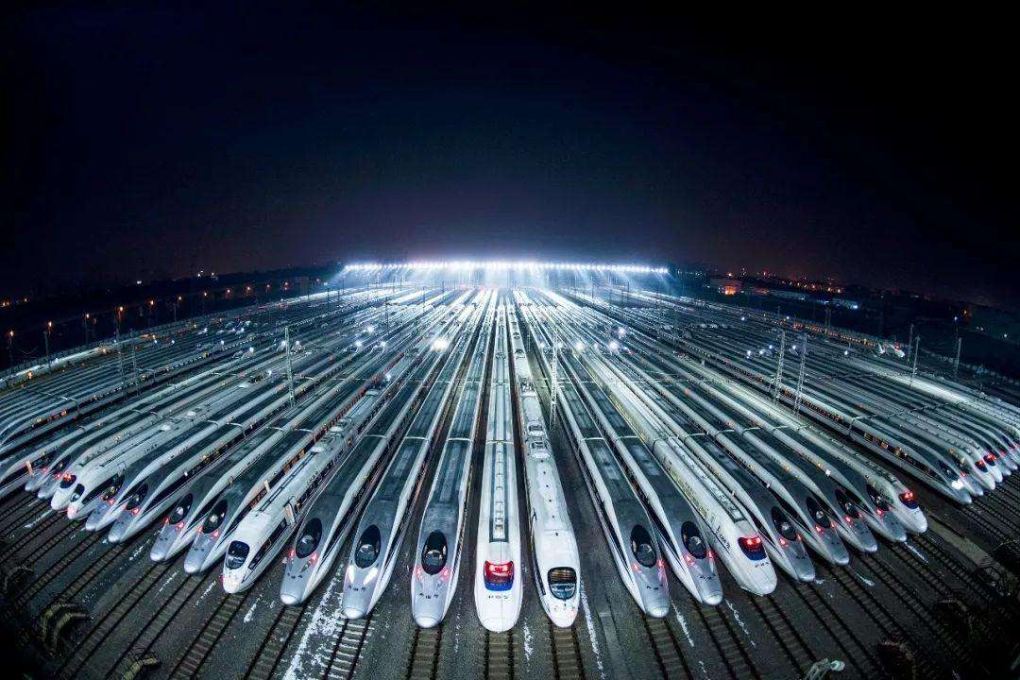
Careful Planning and Reasonable Operation Enable Public Lighting to Be Profitable
PPP and other Operation Modes
LED Ad Placement
Micro Base Station Resource Leasing
Wireless Ad Push

Slide 11

Why
What are Huawei’s advantages in the industry?

Slide 12

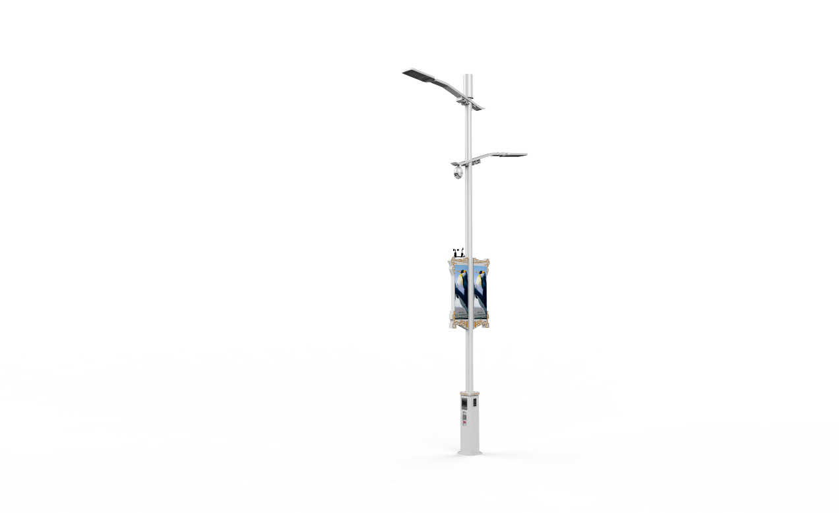

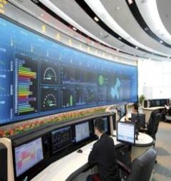
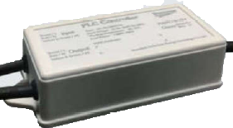
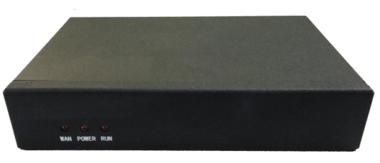
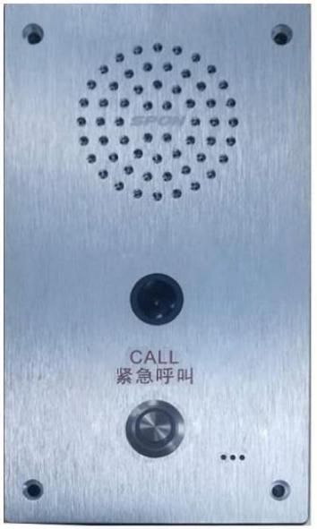
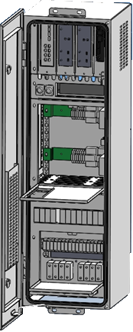

Overall Architecture of the City IoT, With Lamp Poles at Entry
Lamp Pole
IoT Gateway
Network
IoT Platform
Application
Micro base station
Intelligent lighting
Camera
Sensor
PLC lamp control
Data acquisition instrument
Standard Interface
Wi-Fi
One-key alarm
Advertising screen
Smart distribution box
Multi-level control of street lamps
PLC-IoT coverage
Open IoT
Trusted access
Reliable transmission
Centralized NM
Visualized monitoring infrastructure
Smart IoT
Secure & Reliable
Unified O&M

Slide 13
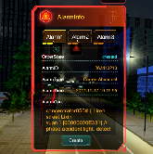
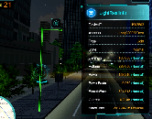
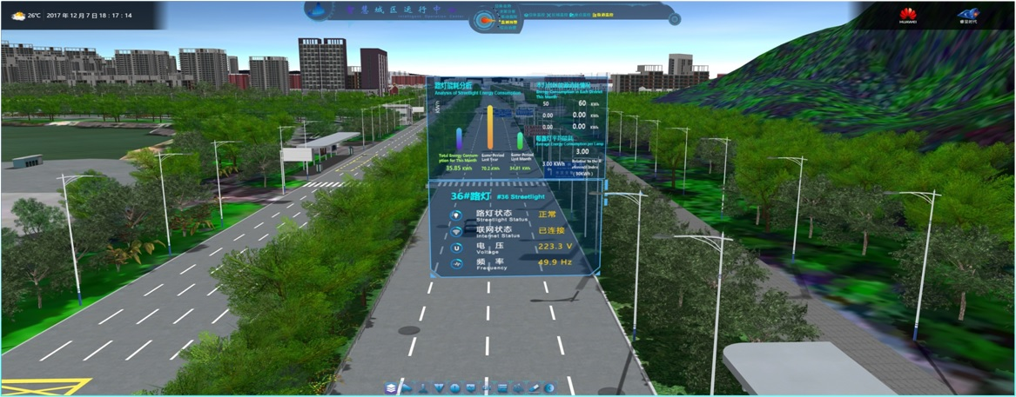
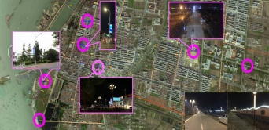
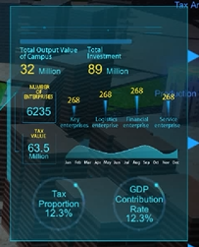
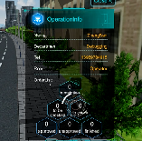

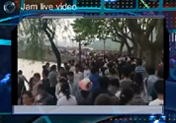
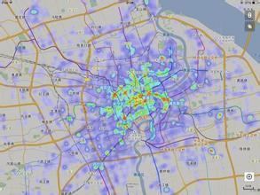
Comprehensive Urban IoT Management: From Macro to Micro
IoT Smart Management Platform
Smart & intelligent light-control policies reduce the energy consumption of city public lighting by 50%+
Visualized and real-time street lamp management makes smart lighting clear and efficient
Unified video surveillance access and human traffic warnings comprehensively improve city security
Data mining and big data analysis help city leaders make smart decisions

Slide 14
Huawei Self-Developed Power Line Carrier Technology: Enabling Remote Intelligent Control of Street Lamps
1
2
3
OFDM modulation dynamically adjusts communication channels, avoiding interference, and ensuring stable data transmission
Low latency, fast communication speed, real-time performance on the platform
Applicable to most municipal road needs, supports large-scale networking and reduces deployment costs
Smart Pole A
Large bandwidth, low latency support for more service access
Supports multi-level relay, long-distance deployment
Supports remote upgrade
PLC lamp control
PLC lamp control
Large Bandwidth, Low Latency
Smart Pole B
PLC-IoT Line
… …
PLC lamp control
PLC lamp control

Slide 15



Optical Fiber + Wireless Backhaul Network Result in Widespread, All-Scenario Coverage of Urban IoT
Hilly Areas
Aggregation Network
Operation Center
Wireless transmission and energy infrastructure technologies are combined for lamp pole access in various difficult cabling scenarios
Microwave
Solar Energy
RTN510
Seaside and River Beach
Operation Platform
3G
AR532
Fiber
All-optical and high-performance backhaul networks meet future lamp pole industry requirements for capacity expansion
Aggregation Switch
Core Switch
Enterprise Campus
Fiber
AR550C
OLT
Mgmt. Platform
Unified management of electrical and network devices, and massive O&M reduce O&M costs
City Block
PON
EG8084P
Splitter
Authentication Platform

Slide 16
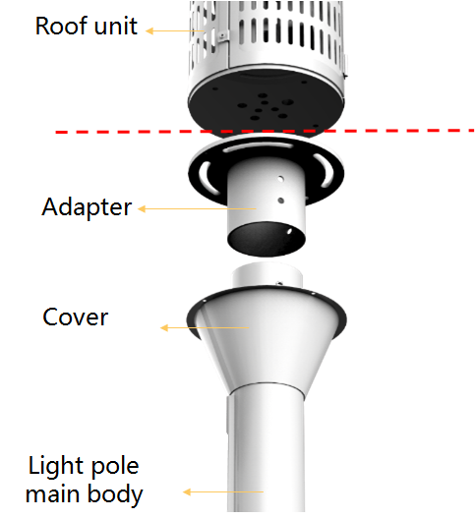
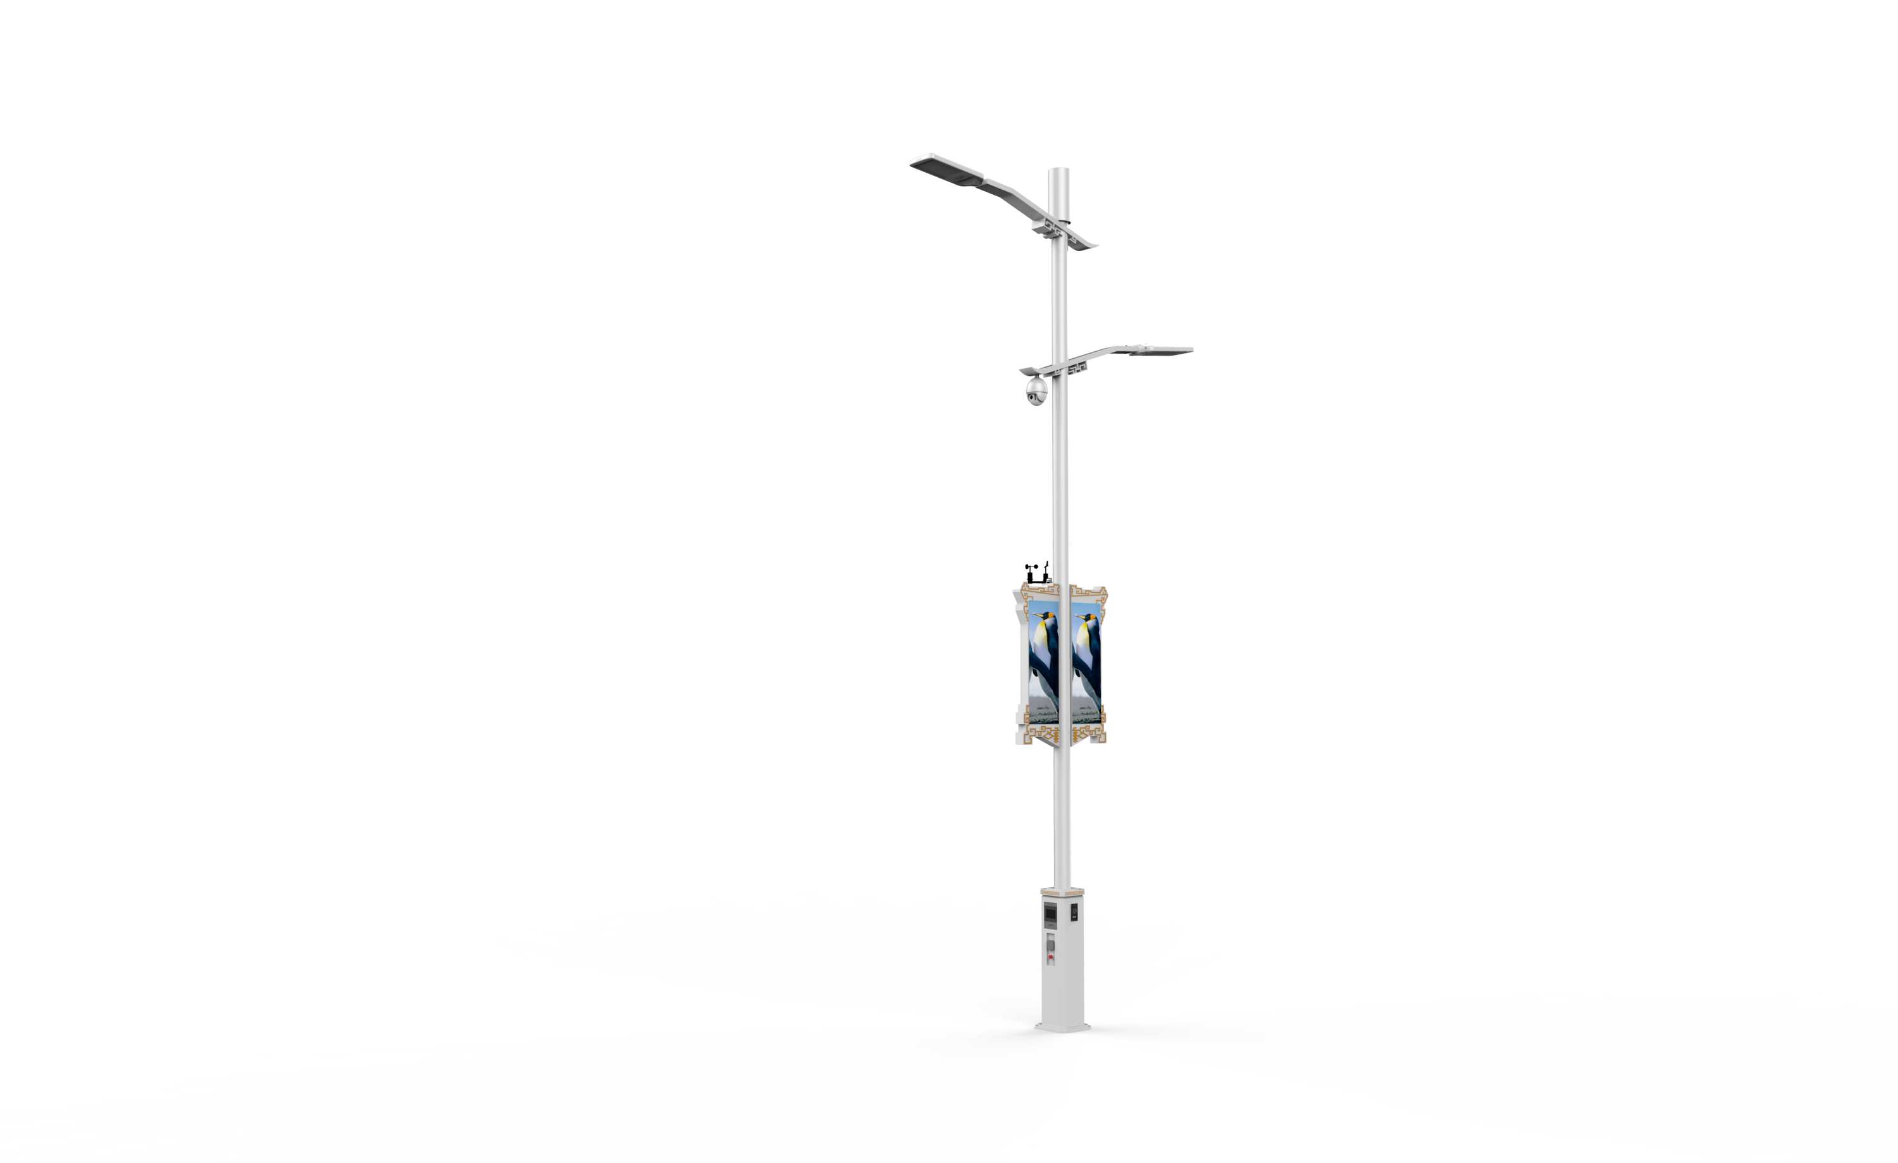
Smart Pole Supports Built-In 5G Micro Base Station to Promote Rapid Development of 5G Industry
Full consideration of wiring, electromagnetic compatibility, and heat dissipation
Overall fusion design is beautiful and ergonomic
Built-in 5G micro base station
1
3
2
4
Switched 2 and 3 for consistency with slide 17
Multiple ways to guarantee the power supply of the micro base station
Reserved fiber accommodates 5G high-performance transmission

Slide 17
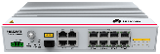
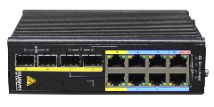

Slide 18

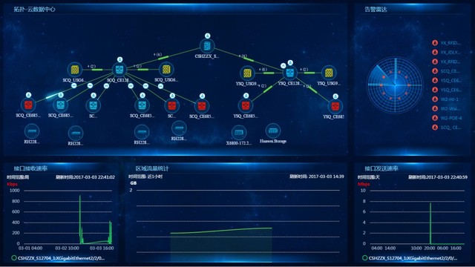
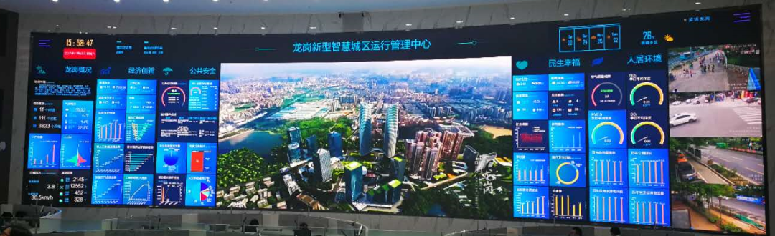






Automatic Deployment of Devices on Entire Network for Unified and Visualized Remote Management, Reducing O&M Costs
Automatic deployment and centralized O&M of ICT devices such as networks, storage devices, and servers reduce manpower requirements and shorten fault time
Intelligent analysis and proper planning of network and storage resources shorten the business rollout time from months to hours
Unified management and efficient planning of various smart IoT services and city information
enable comprehensive monitoring
-EEM-
Air pressure
Temperature
Pollution
Humidity
Screen
Broadcast
Intercom
Garbage truck
Sanitation worker
Trash bin
Integrated network, security, and storage management
Integrated management of smart IoT services

Slide 19




End-to-End Security Solution, Ensuring IoT Data Security
Sensor Control Layer
Network Layer
Platform Layer
A
PP
Network Mgmt.
Application Mgmt.
Agile IoT Gateway
Network
IoT Interface
Computing Resource Mgmt.
IoT Data Subscription and Provisioning
Built-in hardware encryption engine, providing multiple security mechanisms at the MAC layer and transport layer
The LED screen and alarm system are connected based on the PKI certificate
VPN technologies, such as L2TP/GRE/IPsec, ensure data security on the backhaul network
Generate, distribute, and manage certificates at the sensor level

Slide 20

3
How
We are doing...

Slide 21
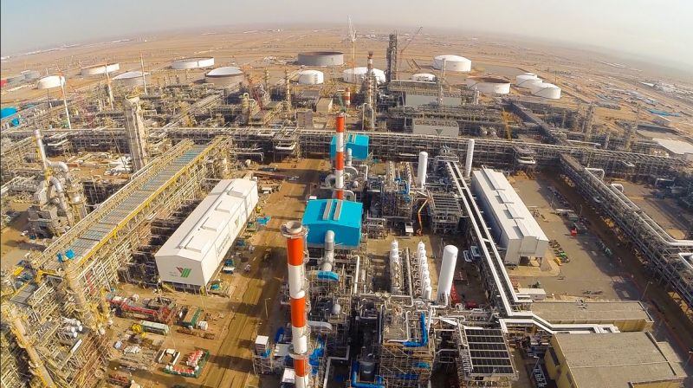


Smart Pole Project of Yanbu Smart City Phase 2: Saudi Arabia
Customer Pain Points
The costs of public lighting and maintenance are high, and faults cannot be handled on time.
Safety risks exist in seaside areas, parks, and other locations.
The current design style of streetlights is singular, and there is no high-tech appearance.
Customer Benefits
Public lighting costs are reduced by 50% and lighting maintenance costs are reduced by 90%
Comprehensive 24/7 video surveillance greatly reduces safety risks
Real-time display of air quality and publicity videos highlight the achievements of smart city construction
In a later stage, the smart screen operation can be used to increase revenue
Solution
Introduce smart pole and deploy smart streetlight solution
Install cameras, panic buttons, and air-quality monitoring on the lamp pole
Install a smart screen on each lamp pole to play ongoing publicity videos of Yanbu

Slide 22

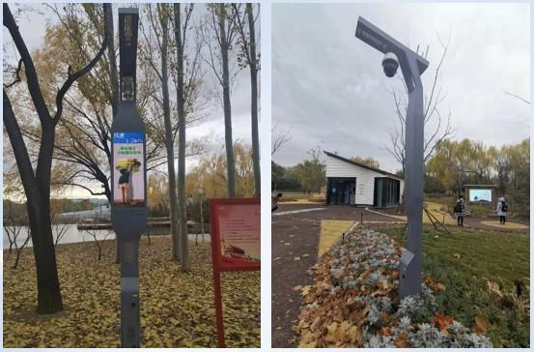
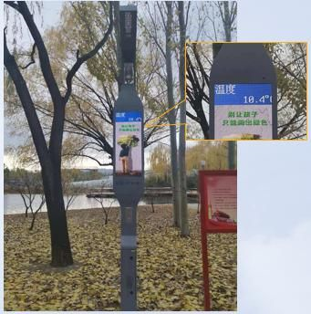


Smart Pole Project in Haidian Park: Beijing
Customer Requirement
Guided by the 13th Five-Year Development Plan of Smart Haidian, Beijing Haidian District considers Smart Park an important part of Smart City construction. The goal is to improve the living quality of residents, raise the overall living standards of the people, and enhance the happiness of public life.
Solution
Customer Benefits
Build a public lighting platform with LED lighting + PTZ + Wi-Fi. There is 360° video surveillance and wireless Internet access in the park.
The LED screen of the lamp pole is used to publicize information in real time, and promote public awareness.
Panic button provides instant emergency calling for a safe and secure park.
A total of 28 smart poles are deployed.
Saves on secondary energy usage and reduces costs
Provides intelligent inspection of park assets and timely repairs with quick and efficient maintenance
Standardizes social safety by detecting and preventing social safety issues in advance
Improves the image of the park and the LED screen promotes the park’s culture

Slide 23
All logos and images displayed in this document are the sole property of their respective copyright holders. No endorsement, partnership, or affiliation is suggested or implied.

